Slide 1
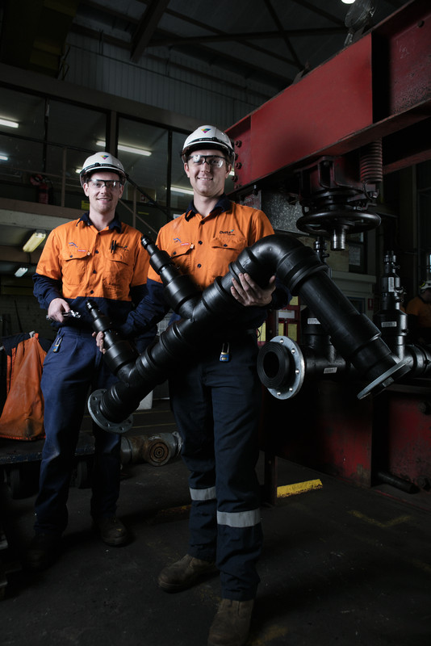


Human Factors
Information Session
To download the Electrical Arc Flash Hazard
Management Guideline (EAHMG), please scan:
For PDF
For video

Slide 2

Overview of session
The purpose of this information session is to:
Provide a Background to Human Factors
List the types of Human Factors
Describe of Human Factors
Provide examples of strategies for addressing Human Factors
Provide examples of incidents highlighting involvement of Human Factors
Describe tools that exist in your workplace for addressing human factors.
This information session is intended to run alongside the Electrical Arc Flash Hazard Management Guideline (EAHMG) Human Factors Poster Campaign:

Slide 3

Background to human factors
Human factors are the wide range of issues that affect how people perform tasks in their work (and non-work environments); how they interact with each other across teams, equipment and workplaces and how they interact with management systems and technology.
Human factors are the social and personal skills traits which can complement (but also distract from) technical skills and they are important for safe and effective electrical work.
When investigating incidents in the workplace Human Factors are often noted.

Slide 4

Vulnerable Workers
Increasingly there is growing awareness for consideration of the general effect of human factors and of the specific requirements of people deemed ‘vulnerable’ and currently working in the Generation Sector.

Slide 5
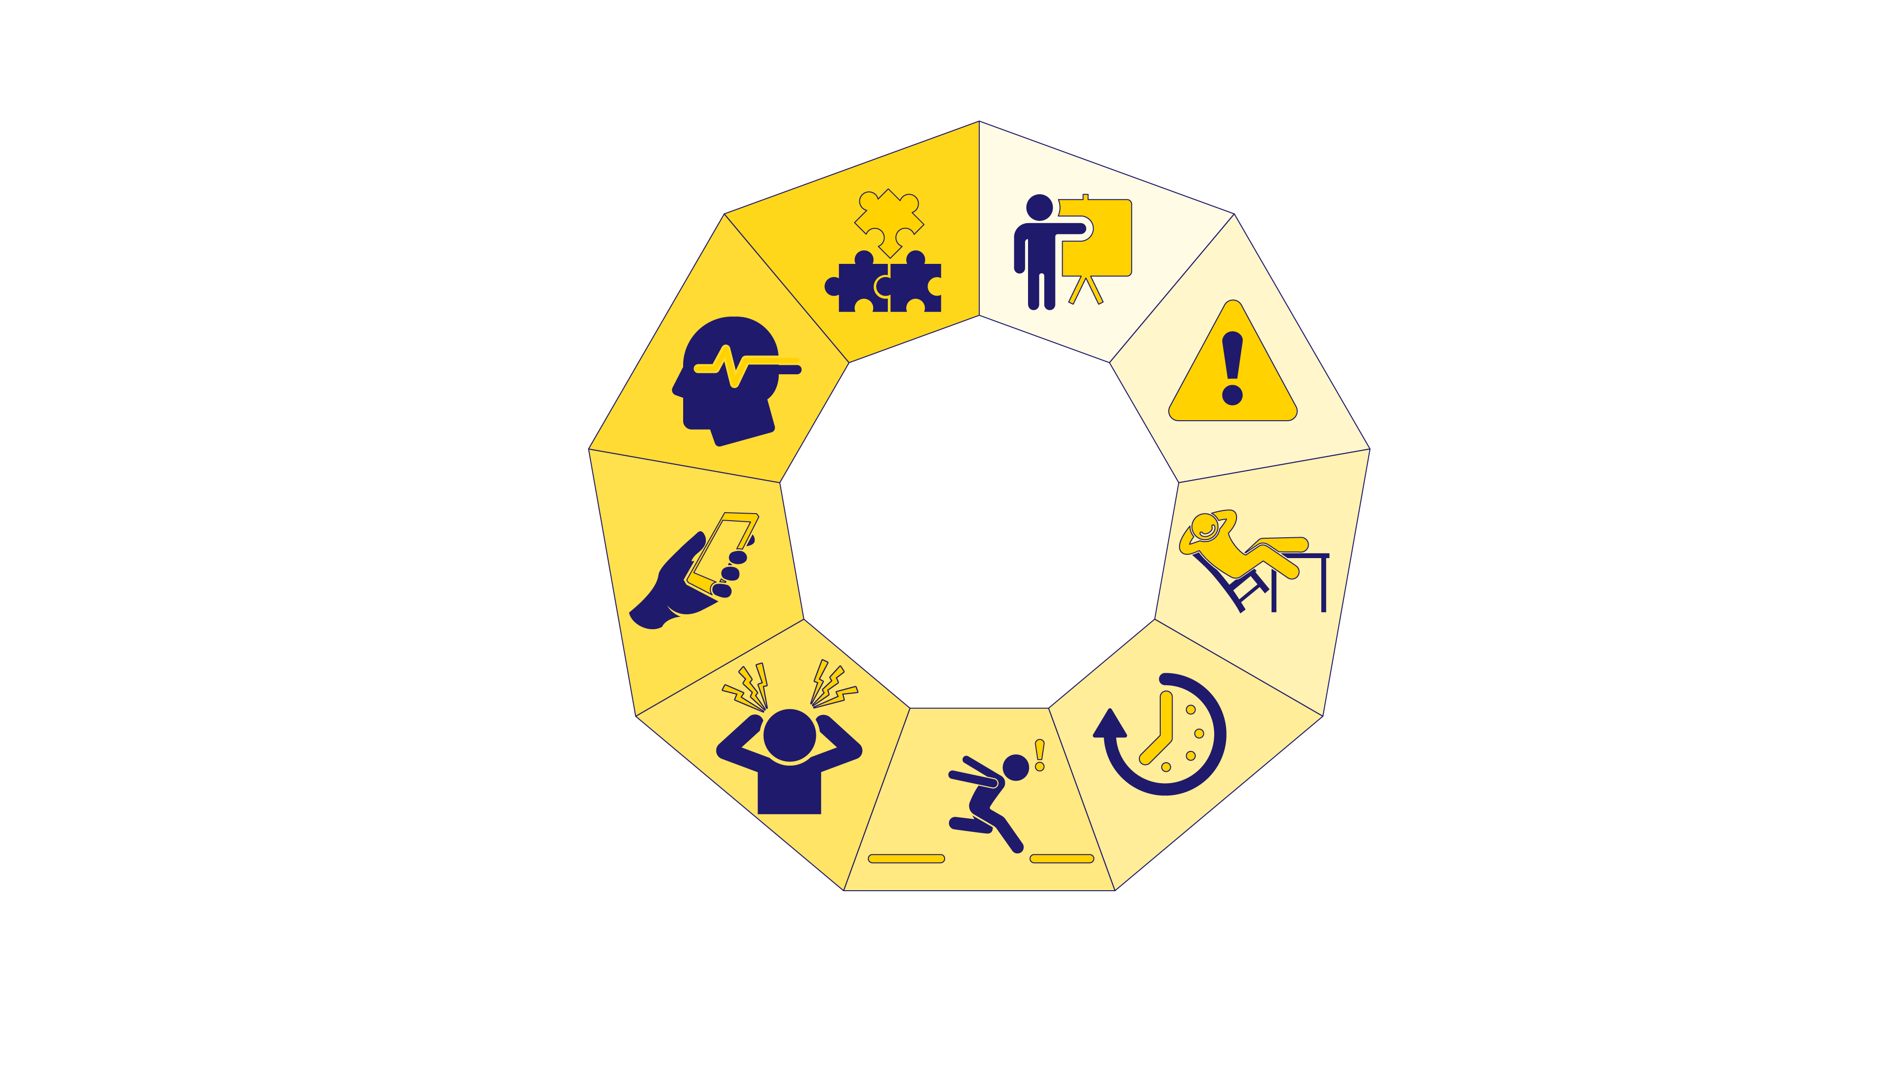

Slide 6
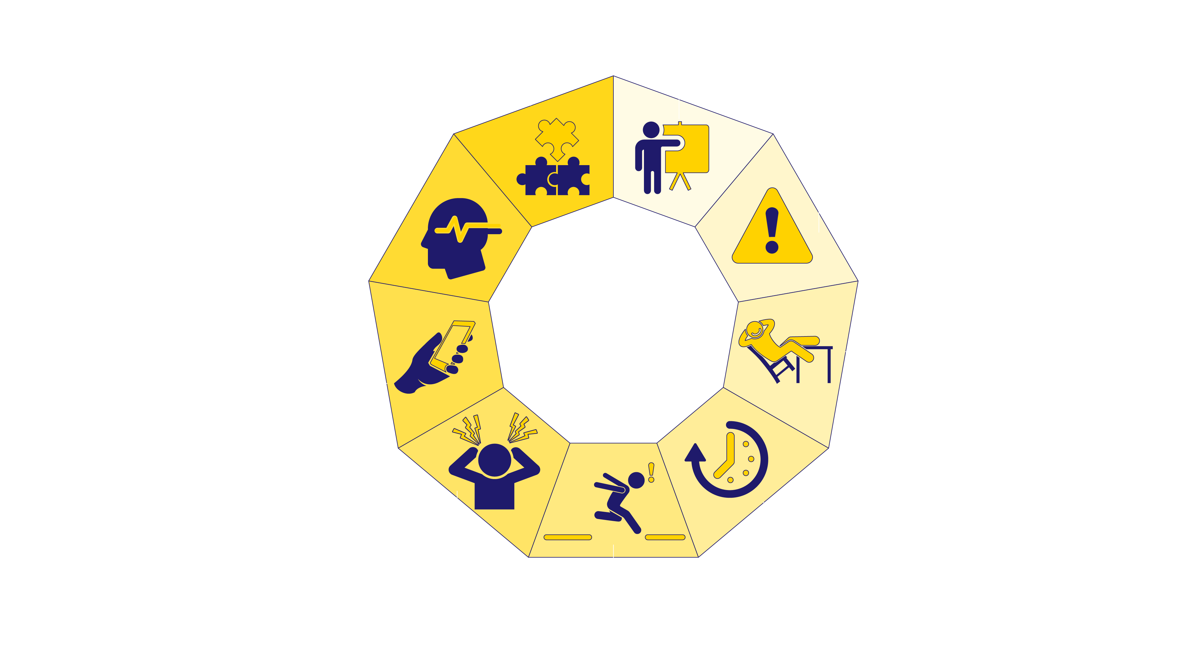

Slide 7
Human Factors & Vulnerable Personnel
Vulnerable
Human Factors
Incidents
Years of experience

Slide 8

Strategies to Manage Human Factors
Human Factor
Consideration of Human Factor Risk Control
Commit to and implement minimum competency requirements when working on / around electrical arc flash hazards
Instruction, Supervision, Information or Training in Human Factors
Appropriate worker selection and monitoring for the ongoing suitability of workers selected to perform relevant works
Training &
Competency

Slide 9

Strategies to Manage Human Factors
Human Factor
Consideration of Human Factor Risk Control
Verification activities. Isolation, plant ID and activity required.
Appropriate worker selection and monitoring for the ongoing suitability of workers selected to perform relevant works.
Stop and think processes (Take 5).
Ongoing safety observation process (Behavioural based).
Management, Team Leader / Supervisor and Peer walkdowns
Effective QA documentation – Switching or job instruction
Interlock and control – error tolerant equipment
Errors, mistakes
& lapses

Slide 10

Strategies to Manage Human Factors
Human Factor
Consideration of Human Factor Risk Control
Ensure levels and type of supervision match the actual (or potential) arc flash hazards and risk
Commit to arc flash awareness activities by way of alerts, training, refreshers, toolbox talks, and lessons learned (post industry incidents and accidents).
Complacency

Slide 11

Strategies to Manage Human Factors
Human Factor
Consideration of Human Factor Risk Control
Executive and Senior Management oversight
Proper planning and resourcing for activities
Higher risk activities emphasised in risk assessment
Management, Team Leader / Supervisor and Peer walkdowns
Time pressure

Slide 12

Strategies to Manage Human Factors
Human Factor
Consideration of Human Factor Risk Control
Ensure levels and type of supervision match the actual (or potential) arc flash hazards and risk.
Accountability process implement for all levels of business.
Executive oversight of competing business drivers.
Violations

Slide 13

Strategies to Manage Human Factors
Human Factor
Consideration of Human Factor Risk Control
Simple English documentation and signage.
Local signage.
Removal of detail not required by person undertaking activity.
Diligence towards the creation of simple software systems and processes for Permit to Work Systems and other isolation tasks.
Information overload

Slide 14

Strategies to Manage Human Factors
Human Factor
Consideration of Human Factor Risk Control
Ensure levels and type of supervision match the actual (or potential) arc flash hazards and risk.
Stop and think processes (Take 5).
Ongoing safety observation process (Behavioural based).
Management, Team Leader / Supervisor and Peer walkdowns.
Distractions

Slide 15

Strategies to Manage Human Factors
Human Factor
Consideration of Human Factor Risk Control
Ensure levels and type of supervision matches the actual (or potential) arc flash hazards and risk.
Stop and think processes (Take 5).
Ongoing safety observation process (Behavioural based).
Management, Team Leader / Supervisor and Peer walkdowns.
Employee Assistance Programs (EAP) and other Mental Health First Aid assistance in the event of worker disclosure of mental health issues and concerns
Mental health issues
& concerns

Slide 16

Strategies to Manage Human Factors
Human Factor
Consideration of Human Factor Risk Control
Cultural audit
Accountability process implement for all levels of business
Ensure levels and type of supervision matches the actual (or potential) arc flash hazards and risk
Stop and think processes (Take 5)
Ongoing safety observation process (Behavioural based)
Management, Team Leader and Supervisor and Peer walkdowns
Workplace Culture & other organisational / team factors

Slide 17
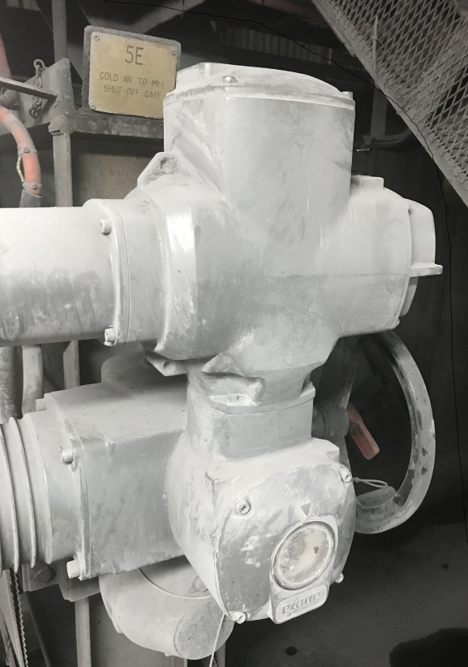
Incidents with Examples of Human Factors
Incident: 5E Mill Cold Air Gate
Example of Human Factor
Errors, mistakes & lapses
Information overload
5E Mill Cold Air Gate was incorrectly isolated in the open position.
Excess air in mill was found to have been as a result of the 5E Mill Cold Air Gate incorrectly being isolated in the open position.
Distractions

Slide 18
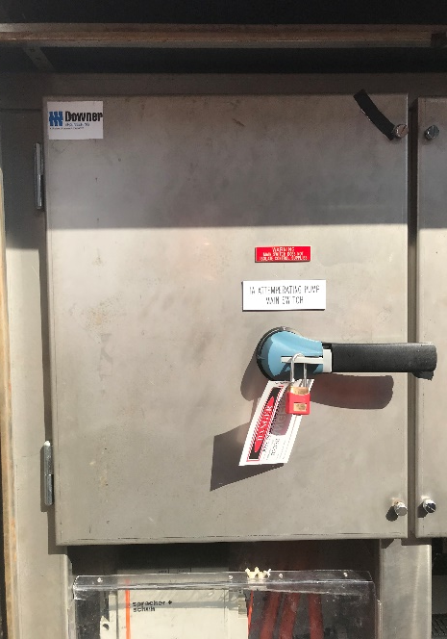
Incidents with Examples of Human Factors
Incident: CW Canal Attemperating Pump 1A
Example of Human Factor
Errors, mistakes & lapses
Information overload
Distractions
Danger Tag & Lock applied to incorrect apparatus, PRI verified incorrectly

Slide 19
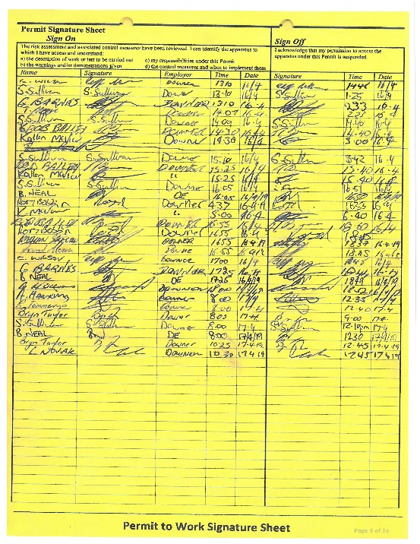
Incidents with Examples of Human Factors
Incident: Confined Space Stand-by Not Signed onto PTW
Example of Human Factor
Training & competency
Errors, mistakes & lapses
Time pressure
Workplace culture
Confined space Stand-by person failed to sign onto the PTW.

Slide 20
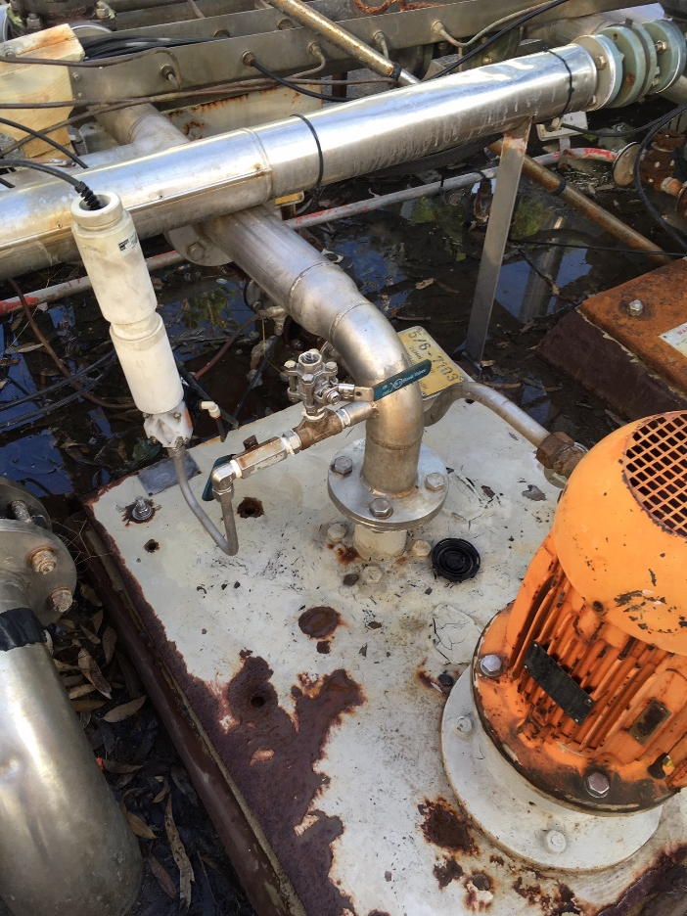
Incidents with Examples of Human Factors
Incident: Caustic Effluent to the face whilst
operating plant in the Demin
Example of Human Factor
Training & competency
Errors, mistakes & lapses
Complacency
Time pressure
Violations
Did not submit an RFA for an Operational Check In-service.
Person not certificated to operate plant without a permit.
Workplace culture

Slide 21
INSERT OWN EXAMPLE
INSERT OWN INCIDENTS
INSERT OWN HUMAN FACTORS

Slide 22
INSERT OWN EXAMPLE
INSERT OWN INCIDENTS
INSERT OWN HUMAN FACTORS

Slide 23

Tools to Manage Human Factors in your workplace
INSERT OWN EXAMPLES
This information session is intended to run alongside the Electrical Arc Flash Hazard Management Guideline (EAHMG) Human Factors Poster Campaign:
To download the Electrical Arc Flash Hazard
Management Guideline (EAHMG), please scan:
For PDF
For video

